Slide 1



Weekly Progress: Embedding 1M Second Batch Dataset
On Development of an on-Premise AI Product Recommendation Model Using Open-Source LLM
Monir (248810)
16 April 2025
Department of Artificial Intelligence Convergence

Slide 2

Project Description
Project Title
Development of an on-Premise AI Product Recommendation Model Using Open-Source LLM
Company: Narosu Co. Ltd.
Project Description
The e-commerce market is becoming increasingly competitive, requiring advanced recommendation systems.
Large marketplaces use sophisticated AI models, but independent online store operators lack such solutions.
This project aims to develop an AI-powered product recommendation system tailored for self-managed online stores.
By analyzing customer preferences, the system will suggest products that align with their interests.
Project Objective
Develop an AI-based search and recommendation system that analyzes user input sentences and recommends the TOP 5 most relevant products based on semantic similarity.
Utilize Natural Language Processing (NLP) and vector search technology to provide a highly refined search experience.
Deploy in an on-premise environment to ensure data privacy and full control over the recommendation process.
1

Slide 3

Company Requirements
Selected Model and Vector Store:
Embedding Model: text-embedding-ada-002
Vector DB/Search: Qdrant (High-dimensional vector indexing, Cosine similarity, Metadata Filtering, Scalable Hybrid Search)
LLM Reasoning: GPT-3.5 turbo /4o or Llama 3.1 8B instant
LangChain Framework for LLM
UI Framework: Gradio (Displays chatbot, takes input, shows recommendations and images)
API Architecture: Gradio is the API + frontend layer but Plan to integrate FastAPI also. Gradio Manages chatbot UI and function bindings internally
2

Slide 4

System Configuration (AI Model) Diagram
3

Slide 5
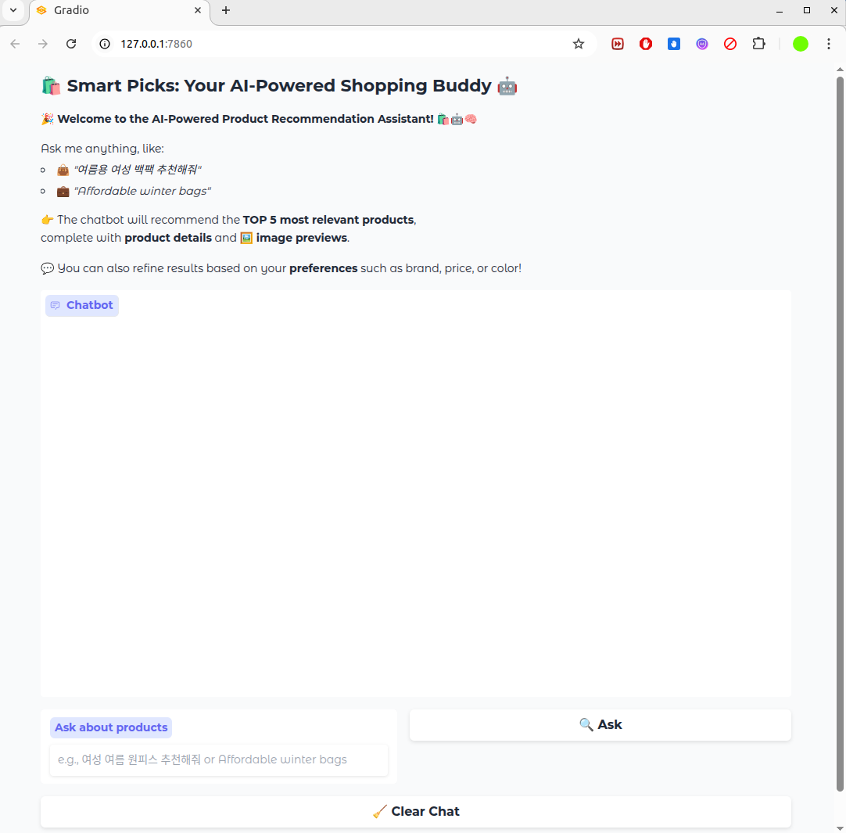
Web view of ChatBot User Interface (UI) Using Gradio
4

Slide 6
Project Schedule (Gantt Chart)
Phase | 2025
 | March |  |  |  | April |  |  |  | May |  |  |  | June
 | 1 | 2 | 3 | 4 | 1 | 2 | 3 | 4 | 1 | 2 | 3 | 4 | 1 | 2
Project Understanding and Data Collection
Data Analysis and Pre-processing
Model Selection and Training
System Development
Chatbot UI Development
Testing and Deployment
5

Slide 7

Communication with Company
Hello.
This is Narosu Lim Seon-oh.
I will send you the 2nd Excel format test data that I mentioned when sharing the 1st.
Please check and feel free to answer any further requests or questions .
Datasets
OwnerClan attribute refined about 1 million Excel format test data (Attachment 1)
  The initial plan was 4 million, but it was judged that it was too difficult to process too much data to try the on-premise method, so it proceeded with about 1 million data.
Datasets
If the primary attribute has been refined but is not considered necessary by the students, it is okay to delete it.
Please send us a list of the technology stacks that students will use.
6

Slide 8
Comparison Gradio (API + frontend layer) vs FastAPI
Feature | Gradio | FastAPI / Flask / Django
🛠 Setup Speed | ✅ Super fast — UI + backend in 1 Python file | ❌ Slower — need to separate backend, frontend, routes
👨‍💻 UI Integration | ✅ Built-in chatbot UI, image preview, markdown support | ❌ No built-in UI — needs JS/HTML or separate frontend
📦 Ideal For | ML demos, internal tools, research, small AI assistants | Full-stack apps, REST APIs, scalable backend systems
🔒 Auth / Login System | ❌ No built-in user management | ✅ Django/FastAPI support full user systems
🔗 RESTful API Access | ⚠️ Limited (behind the scenes) | ✅ Full RESTful APIs for any client
🌐 Real Deployment | ✅ Easy to host with Hugging Face, localhost, etc. | ✅ Production-ready with Docker, Nginx, Gunicorn
📊 Analytics / Logging | ❌ Manual setup | ✅ Easier integration with observability tools
🔄 Asynchronous Support | ⚠️ Basic | ✅ Native async support (FastAPI excels here)
📷 Image Handling | ✅ Built-in image uploads, display | ❌ Manual handling
I selected Gradio + FastAPI to get the best performance. Used Gradio for UI, and FastAPI can handle the backend.
7

Slide 9
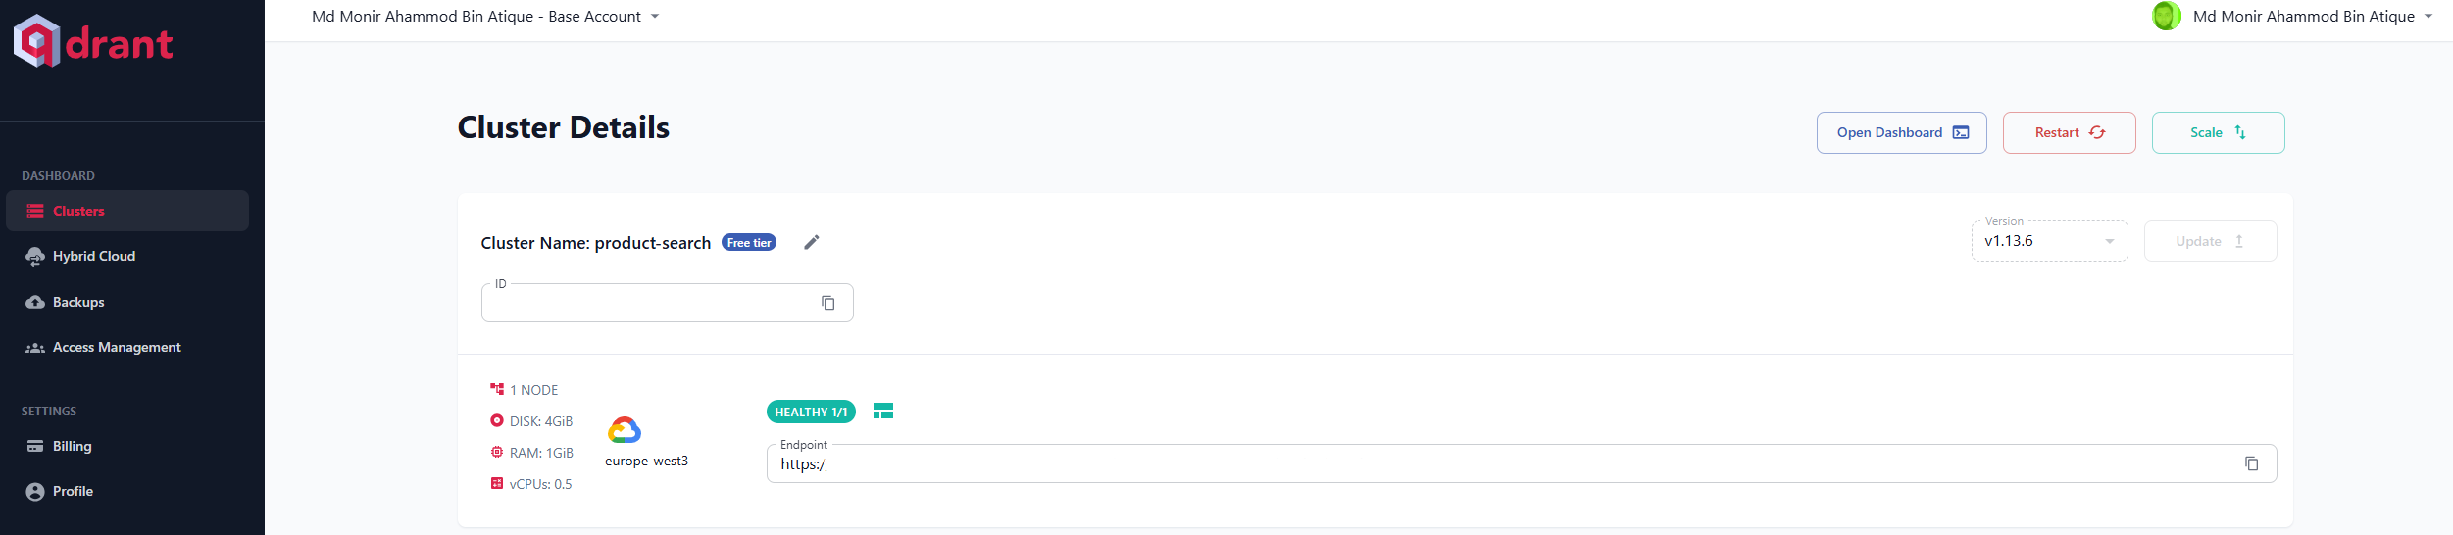
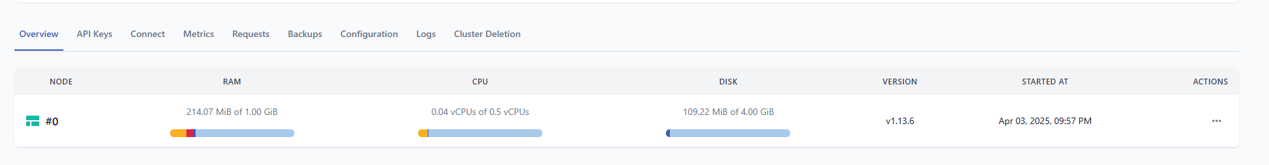
Qdrant Cloud
Qdrant Cloud: creating cluster
Qdrant Cloud: storing embedding on cloud cluster
8

Slide 10
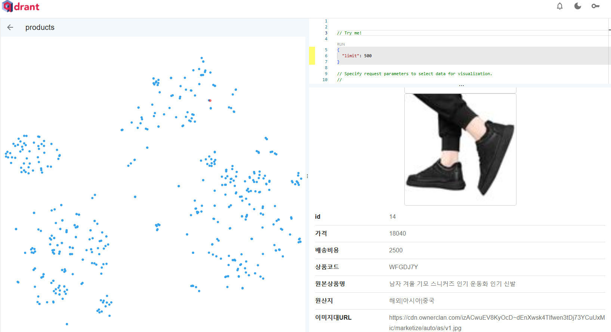
Store 1st Batch Data (7700) on Qdrant Cloud
All product data visualization
9

Slide 11
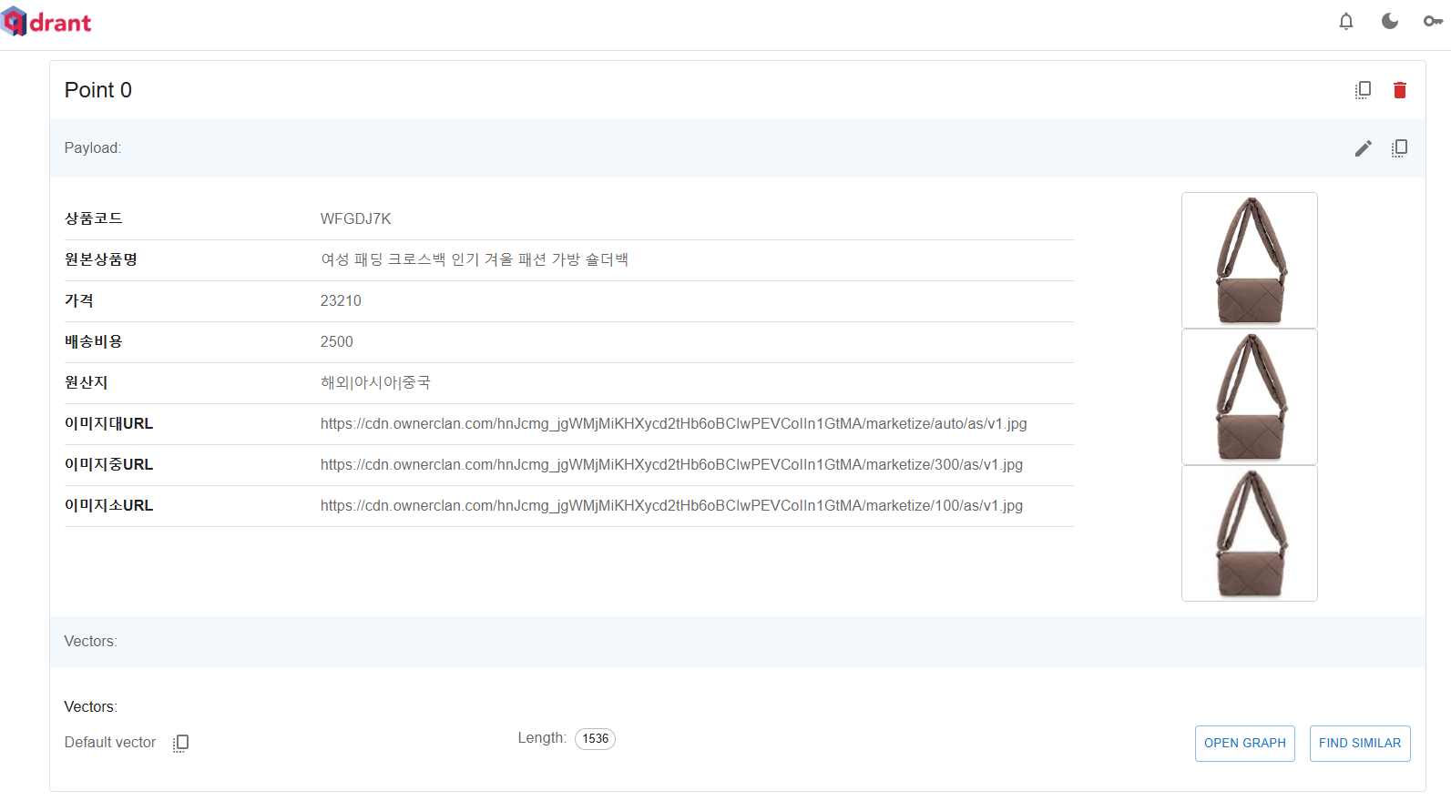
Data Description of 1st Batch on Qdrant Cloud
Point in Qdrant Cluster: Product Description
10

Slide 12
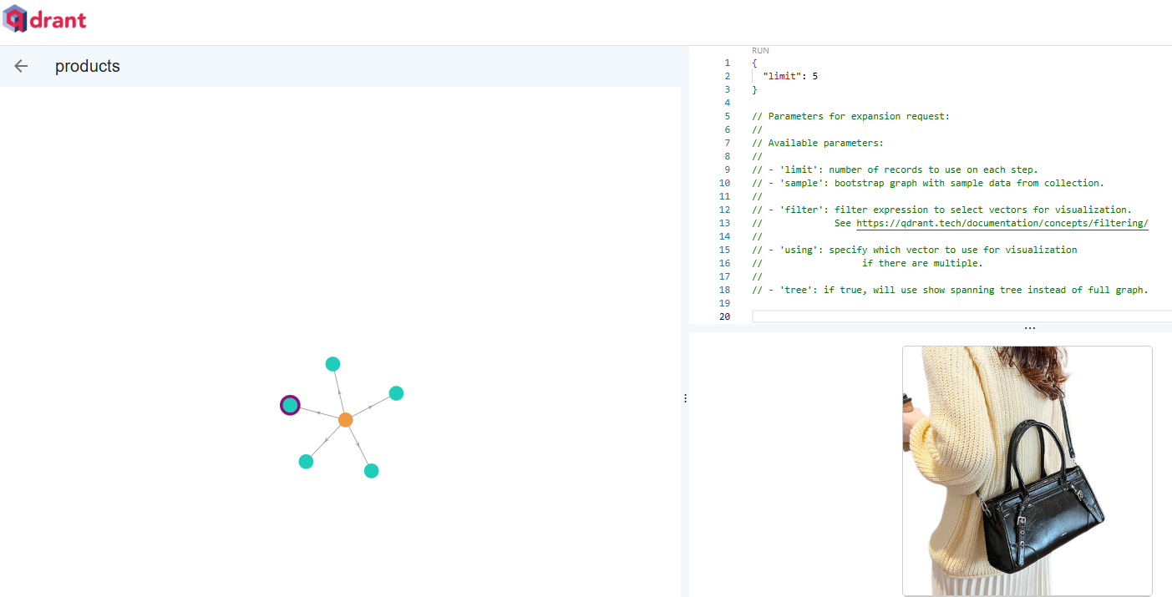
Similar Data Points of 1st Batch on Qdrant Cloud
Similar product graph on cloud cluster
11

Slide 13
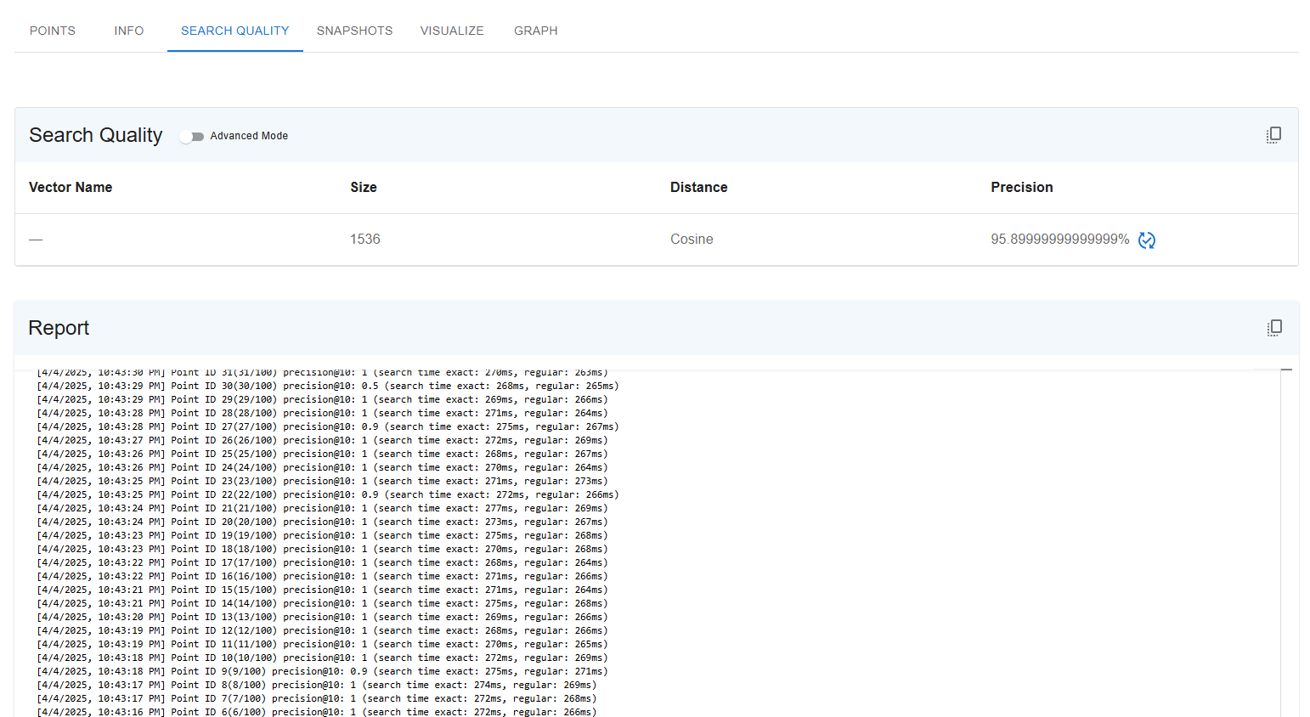
Search Quality of 1st Batch on Qdrant Cluster
Product search quality based on cosine similarity
12

Slide 14
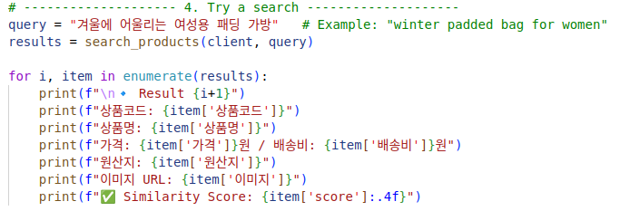
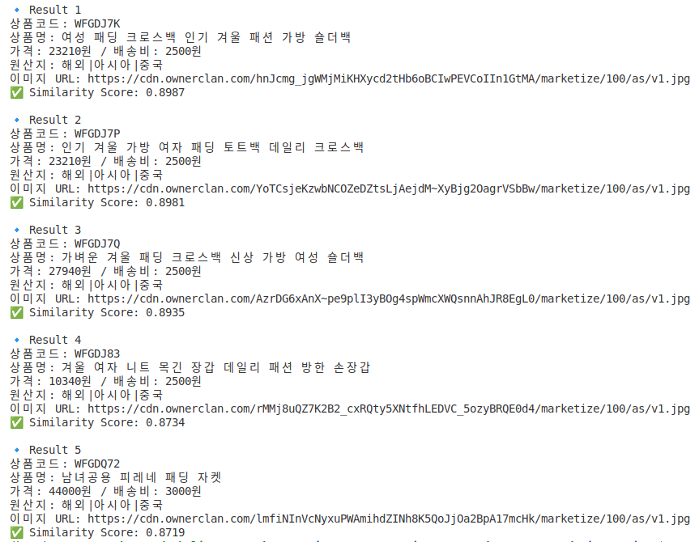
Example of a Product Search on the 1st Batch Dataset (7700)
Product search with example
13

Slide 15
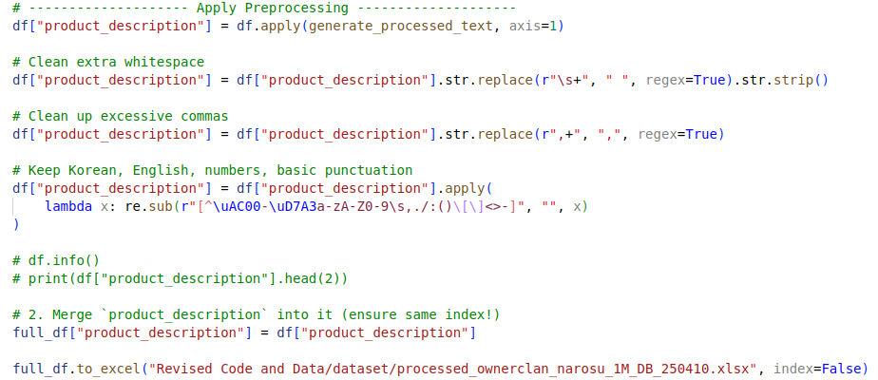
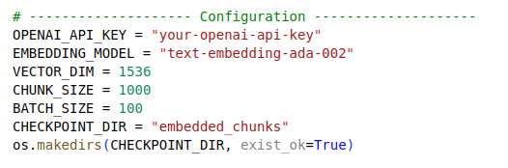
Pre-processing 1M Second Batch Dataset
0 상품코드 Product Code 999252 non-null object
1 카테고리코드 Category Code 1000000 non-null int64
2 카테고리명 Category Name 1000000 non-null object
3 원본상품명 Original Product Name 1000000 non-null object
4 오너클랜판매가 Oracle Clan Sales Price 1000000 non-null int64
5 배송비 Shipping Fee 1000000 non-null int64
6 배송유형 Shipping Type 1000000 non-null object
7 최소구매수량 Minimum Purchase Quantity 1000000 non-null int64
8 최대구매수량 Maximum Purchase Quantity 1000000 non-null int64
9 옵션1명 Option 1 Name 383917 non-null object
10 옵션1값 Option 1 Value 383893 non-null object
11 옵션2명 Option 2 85239 non-null object
12 옵션2값 Option 2 value 85229 non-null object
13 조합형옵션 Combination option 383875 non-null object
14 이미지대 Image size 65530 non-null object
15 제작/수입사 Manufacturer/Importer 999798 non-null object
16 모델명 Model name 554965 non-null object
17 원산지 Origin 1000000 non-null object
18 키워드 Keyword 1000000 non-null object
19 등록일 Registration date 1000000 non-null object
20 최종수정일 Last modified date 1000000 non-null object
21 정보고시카테고리 Information notice category 999996 non-null
22 정보고시 항목정보 Information notice item information 999899
23 반품배송비 Return shipping fee 1000000 non-null int64
24 독립형 standalone 383875 non-null object
25 조합형 composite 383875 non-null object
Apply preprocessing on 1M data and save the preprocessed data
Set the configuration embedding on 1M preprocessed data
14

Slide 16
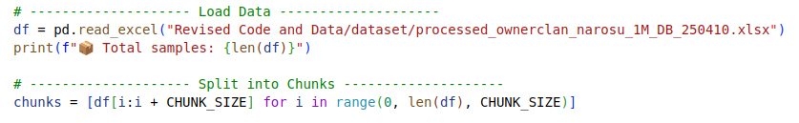
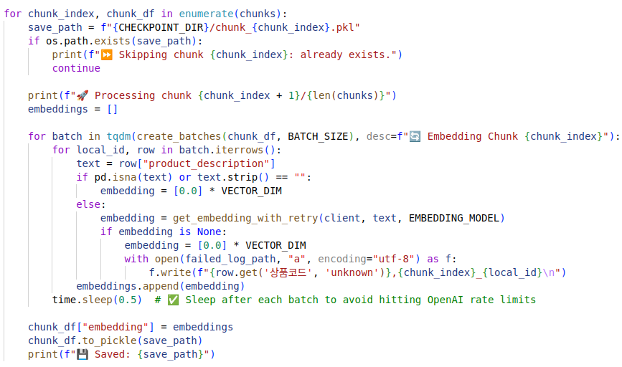
Code for the Embedding of 1M Second Batch Dataset
Load data and split into chunks (Here 1000000/1000 = 1000 chunks)
Main function for embedding on each chunk
15

Slide 17
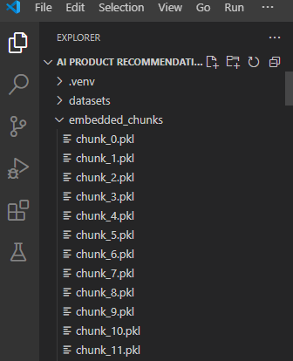
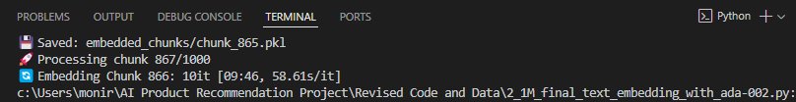
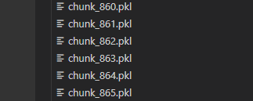
Embedding Status on 1M Dataset (1000 Chunks)
It takes 4 days to embed 870 Chunks (870000) out of 1000 chunks (1M).
…
16

Slide 18
Next Tasks To Do
Next Step
Plan to integrate new 1M embedding data and vector DB with LangChain Framework and RAG.
Choose optimal LLM model.
Try the system with some test queries.
17

Slide 19
Thank You for Listening.
18

